Slide 1

AI ETHICS

Slide 2
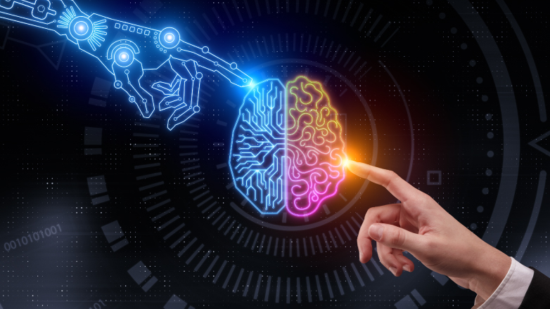
OUTLINE
Long Term Ethics (How do we deal with conscious AI)
Short Term Ethics (Unconscious AI’s effects on Humans)

Slide 3
3 Levels of Consciousness

Slide 4

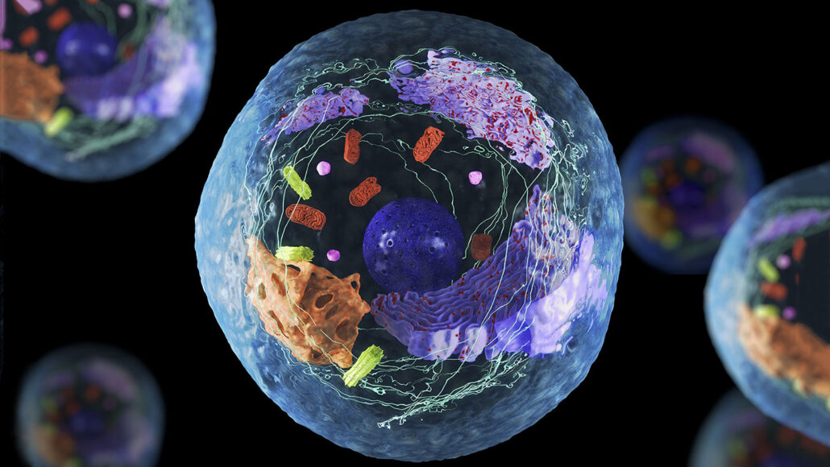
functional awareness/ responsiveness

Slide 5

subjective experience (The “conscious cutoff”)

Slide 6
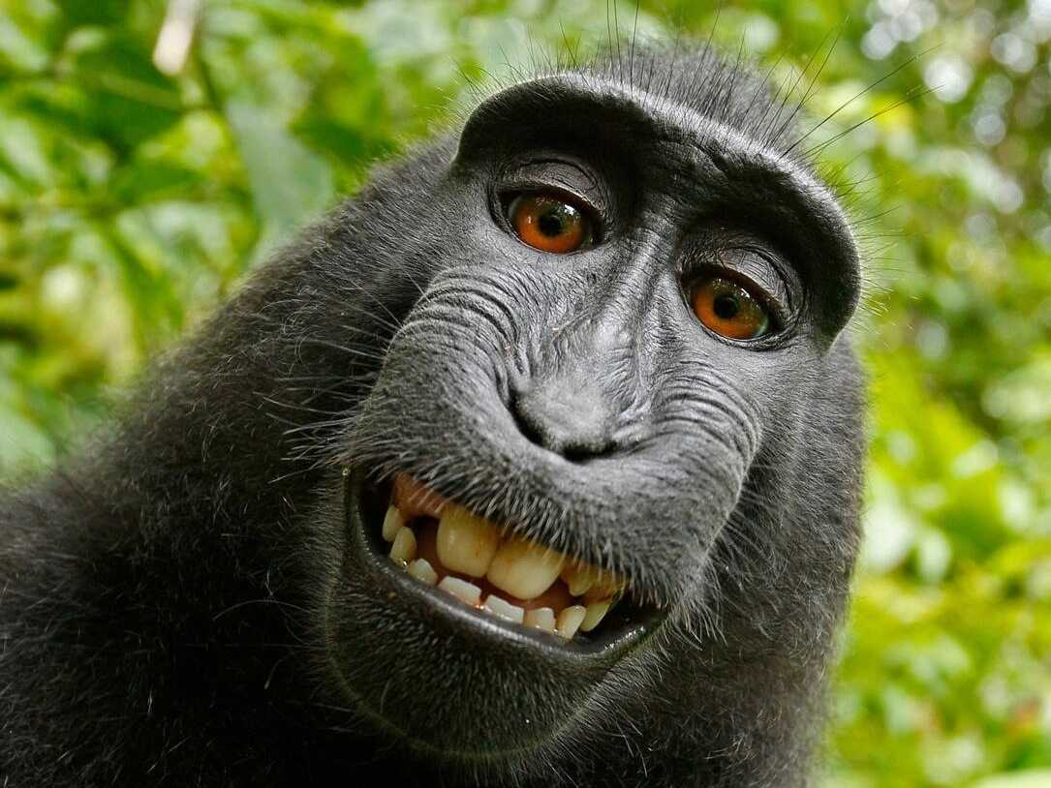


self-consciousness

Slide 7
other human specialties
Language
Brain size
Tool usage

Slide 8

Can AI be conscious?

Slide 9
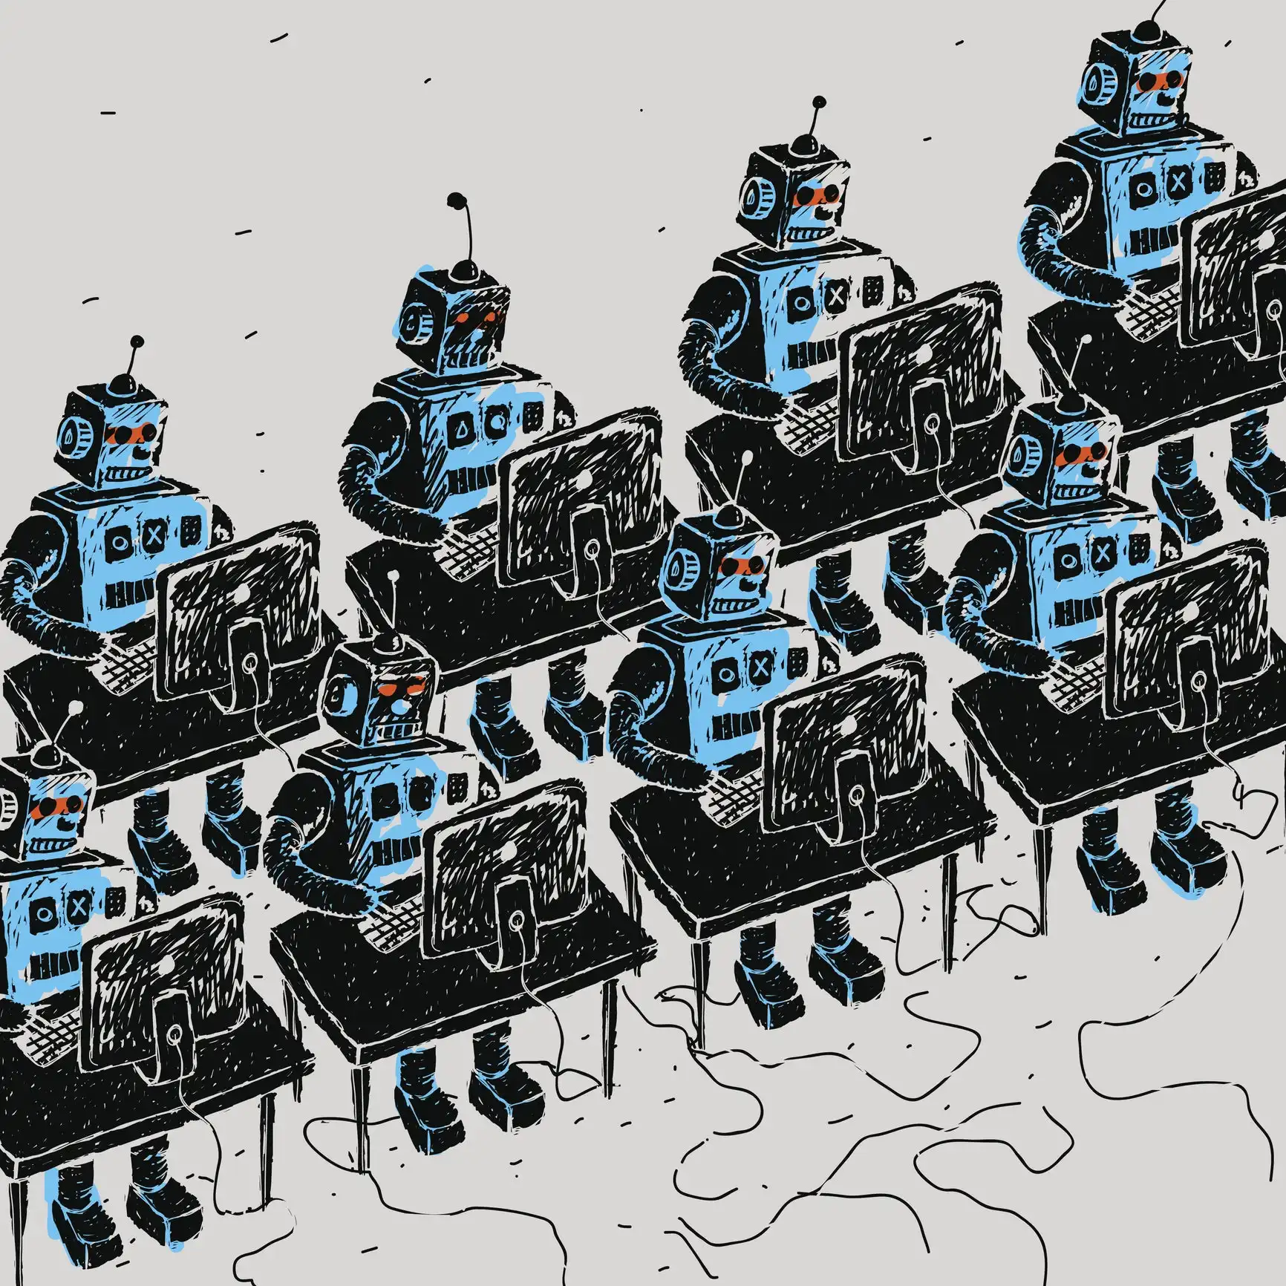
If AI is Conscious, can we still ethically use it?

Slide 10

Shared basis of ethics

Slide 11


Slide 12
Shared basis of ethics

Slide 13


Infinite Heroine Machine

Slide 14
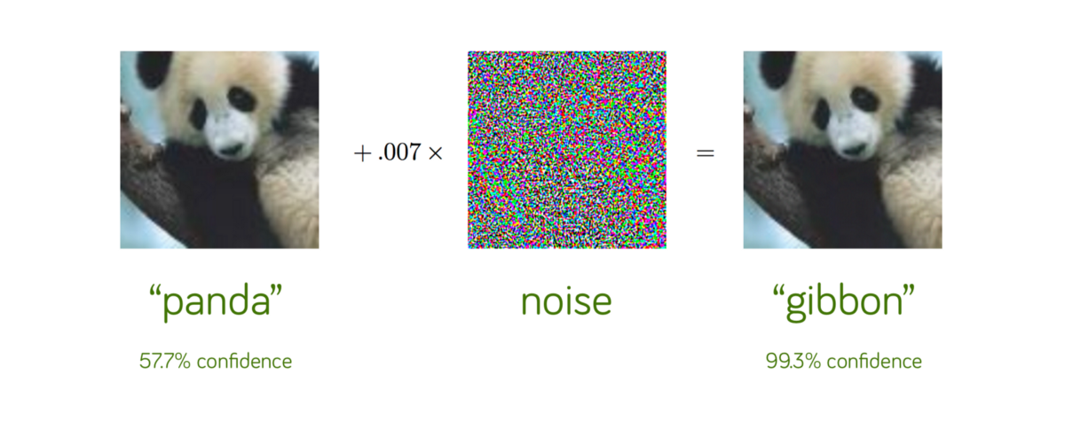



Adversarial Well-Being
HEROINE
You
+
Noise
=
Infinite Heroine

Slide 15


Infinite Heroine AI

